Slide 1
Android User Interface

Slide 2
Views and ViewGroups
Started with Android activity, and how it allows the users to interact with the application.
Activities use Java code to react to user input and perform programming functions.
When an activity wants to change the UI for an application it uses Views and ViewGroups.
These are handled both in XML or in the Java code.

Slide 3
Views and ViewGroups
Typically define the UI for an application using an XML file
During runtime, the XML file is run from the Java program. For example:
setContentView(R.layout.activity_main);

Slide 4
Views and ViewGroups
During compilation, each element in the XML file is compiled into its equivalent Android GUI class, with attributes represented by methods
The Android system then creates the UI of the activity when it is loaded
While it is usually more convenient to create the UI in the XML file, it is possible to change or even create entirely the UI in the Java program

Slide 5
Views and ViewGroups
An activity contains Views and ViewGroups
One or more Views can be grouped together into a ViewGroup
The ViewGroup provides the layout in which you can order the appearance and sequence of Views
Examples of ViewGroups include LinearLayout and TableLayout
A ViewGroup derives from the base class android.view.ViewGroup

Slide 6
Views and ViewGroups
Android supports the following main ViewGroups
LinearLayout
TableLayout
RelativeLayout
FrameLayout
ScrollView
Was AbsoluteLayout but not supported

Slide 7
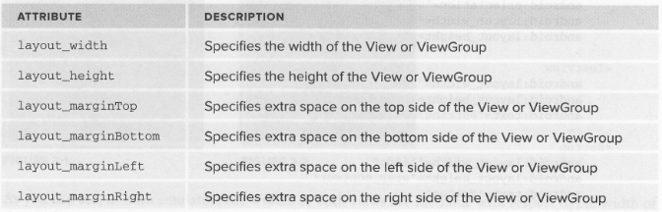
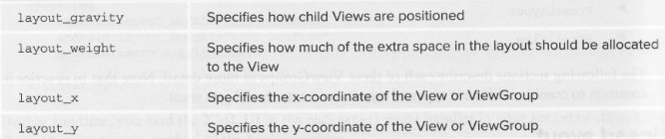
Attributes for Views & ViewGroups
Notes:
Each View and ViewGroup has a set of common attributes, some of which are described here

Slide 8
Views and ViewGroups
Some of these attributes are applicable only when a View is in a specific ViewGroup
For example, the layout_width and layout_gravity attributes are applicable only when a View is in either a LinearLayout or a TableLayout

Slide 9
Views and ViewGroups
Definition of the most common attribute values:
match_parent – uses all the space available up to the size of the parent in that particular direction
wrap_content –size is controlled by the size of the content
the size of the element changes according to the size of its contents so that the contents just fit
A unit of measurement – in this case the element takes on the exact size as indicated by the unit of measurement

Slide 10
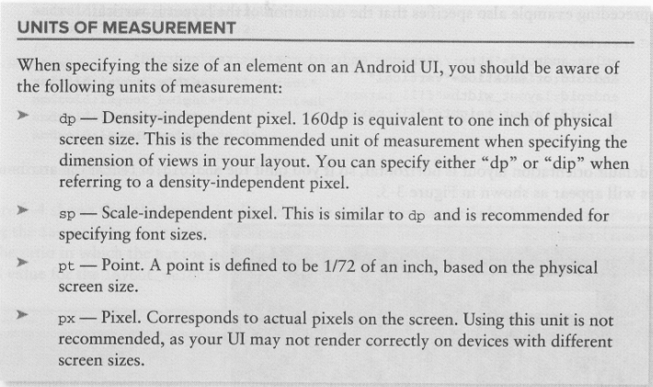
Units of Measurement

Slide 11
RelativeLayout
RelativeLayout, as the name suggests, lays out widgets based upon their relationship to other widgets in the container and the parent container.
To make all this work, we need ways to reference other widgets within an XML layout file, plus ways to indicate the relative positions of those widgets.

Slide 12
RelativeLayout
The easiest relations to set up are tying a widget's position to that of its container:
android:layout_alignParentTop says the widget's top should align with the top of the container
android:layout_alignParentBottom says the widget's bottom should align with the bottom of the container
android:layout_alignParentStart says the widget's left side should align with the left side of the container (in ltr mode)
android:layout_alignParentEnd says the widget's right side should align with the right side of the container (in ltr mode)
android:layout_centerHorizontal says the widget should be positioned horizontally at the center of the container
android:layout_centerVertical says the widget should be positioned vertically at the center of the container
android:layout_centerInParent says the widget should be positioned both horizontally and vertically at the center of the container
Notes:
All of these properties take a simple boolean value (true or false).

Slide 13
Positions relative to other widgets
There are four properties that control position of a widget in relation to other widgets:
android:layout_above indicates that the widget should be placed above the widget referenced in the property
android:layout_below indicates that the widget should be placed below the widget referenced in the property
android:layout_toStartOf indicates that the widget should be placed to before the start of the widget referenced in the property
android:layout_toEndOf indicates that the widget should be placed after the end of the widget referenced in the property

Slide 14
Positions relative to other widgets
Beyond those four, there are five additional properties that can control one widget's alignment relative to another:
android:layout_alignTop indicates that the widget's top should be aligned with the top of the widget referenced in the property
android:layout_alignBottom indicates that the widget's bottom should be aligned with the bottom of the widget referenced in the property
android:layout_alignStart indicates that the widget's start should be aligned with the start of the widget referenced in the property
android:layout_alignEnd indicates that the widget's end should be aligned with the end of the widget referenced in the property
android:layout_alignBaseline indicates that the baselines of the two widgets should be aligned (where the "baseline" is that invisible line that text appears to sit on)

Slide 15
Positions relative to other widgets
So, if we want Widget B to be positioned to the right of Widget A, in the XML element for Widget B, we need to include
android:layout_toRightOf = "@id/widget_a" (assuming @id/widget_a is the identity of Widget A).

Slide 16
RelativeLayout
RelativeLayout also has the ability to have widgets overlap one another
Later children of a RelativeLayout are "higher in the z-axis" than are earlier children, meaning that later children will overlap earlier children if they are set up to occupy the same space in the layout
Both widgets can still be clicked
Clicking on the top widget does not also click the bottom widget
Clicks are handled by the widget on top in the case of an overlap

Slide 17
LinearLayout
LinearLayout is a box model – widgets or child containers are lined up in a column or row, one after the next.
To configure a LinearLayout, you have five main areas of control besides the container's contents:
the orientation,
the fill model,
the weight,
the gravity,
the padding

Slide 18
Orientation
Orientation indicates whether the LinearLayout represents a row or a column.
Just add the android:orientation property to your LinearLayout element in your XML layout, setting the value to be horizontal for a row or vertical for a column.
The orientation can be modified at runtime by invoking setOrientation() on the LinearLayout, supplying it either HORIZONTAL or VERTICAL.

Slide 19
Fill Model
All widgets inside a LinearLayout must supply android:layout_width and android:layout_height properties to control their size.
Three ways of specifying:
A specific dimension, such as 125dp to take up exactly a certain size
wrap_content
match_parent

Slide 20
Weight
Use weight to cover all available space
For example, want two multi-line fields in a column to take up the remaining space in the column after all other widgets have been allocated their space.
set android:layout_width (for rows) to match_parent
also set android:layout_weight

Slide 21
Weight
This property indicates what proportion of the free space should go to that widget.
If you set android:layout_weight to be the same non-zero value for a pair of widgets (e.g., 1), the free space will be split evenly between them.
If you set it to be 1 for one widget and 2 for another widget, the second widget will use up twice the free space that the first widget does.
The weight for a widget is zero by default
Notes:
Show example without weight and then with. Show setting size to 0dp and how that changes things from match_parent

Slide 22
Weight
Can allocate weight on a percentage basis.
To use this technique for, say, a horizontal layout:
Set all the android:layout_width values to be 0 for the widgets in the layout
Set the android:layout_weight values to be the desired percentage size for each widget in the layout
Make sure all those weights add up to 100

Slide 23
Gravity
By default, everything in a LinearLayout is start- and top-aligned.
Create a row of widgets via a horizontal LinearLayout, the row will start flush on the left side of the screen (in ltr)
To change the position need to specify a gravity; i.e. an alignment property
Two types of gravity:
Gravity of a widget within a LinearLayout
Gravity of the contents of a widget or container

Slide 24
Gravity
The android:gravity property of some widgets and containers – which also can be defined via setGravity() in Java – tells Android to slide the contents of the widget or container in a particular direction
For example, android:gravity=“end" says to slide the contents of the widget to the right; android:gravity=“end|bottom" says to slide the contents of the widget to the end and the bottom.

Slide 25
Gravity
TextView supports android:gravity, and the "contents" is the text held within the TextView
LinearLayout supports android:gravity, and the "contents" are the widgets inside the container
Children of a LinearLayout also have the option of specifying android:layout_gravity
Here, the child is telling the LinearLayout "if there is room, please slide me (and me alone) in this direction"

Slide 26
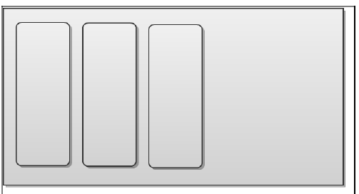
Gravity
For example, let's suppose that we have a horizontal LinearLayout with three child widgets. By default, they will be left-aligned:

Slide 27
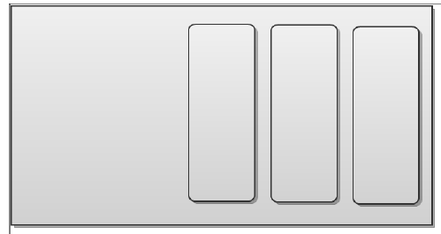
Gravity
If we specified android:gravity=“end" on the LinearLayout, all three widgets would slide over to the right:

Slide 28
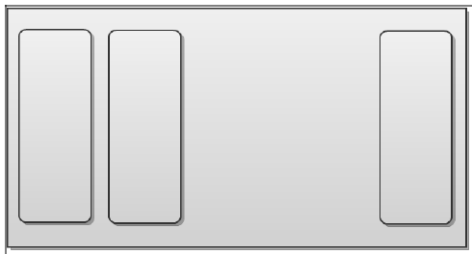
Gravity
If, on the other hand, we left android:gravity alone, but specified android:layout_gravity=“end" on the third widget, that widget alone would slide to the right:

Slide 29
Gravity
For a column of widgets, common gravity values are start/left, center_horizontal, and end/right for left-aligned, centered, and right-aligned widgets respectively
For a row of widgets, the default is for them to be aligned so their texts are aligned on the baseline (the invisible line that letters seem to "sit on"), though you may wish to specify a gravity of center_vertical to center the widgets along the row's vertical midpoint
Notes:
Should not use left or right but may have to if trying to support API <17

Slide 30
Margins
By default, widgets are tightly packed, one next to the other
Control how close together widgets are via margins
Adding margin increases the empty space between the edges and adjacent widgets
Margins can be set in XML, either on a per-side basis (e.g., android:layout_marginTop) or on all sides via android:layout_margin

Slide 31
TableLayout
TableLayout allows you to position your widgets in a grid
Control the number of rows and columns, which columns might shrink or stretch to accommodate their contents, etc
TableLayout works in conjunction with TableRow
TableLayout controls the overall behaviour of the container, with the widgets themselves poured into one or more TableRow containers, one per row in the grid

Slide 32
TableLayout
Need to figure out how widgets work with rows and columns, plus how to handle widgets that live outside of rows
Rows are declared by the developer putting widgets as children of a TableRow inside the overall TableLayout
Control directly how many rows appear in the table
The number of columns is determined by Android; developer controls the number of columns indirectly

Slide 33
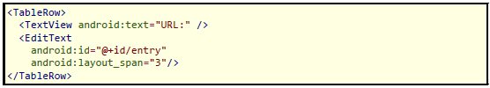
TableLayout
First, there will be at least one column per widget in the longest row
A widget can take up more than one column by including the android:layout_span property, indicating the number of columns the widget spans
Like colspan attribute in table cells in HTML
In the below XML layout fragment, the field spans three columns.

Slide 34
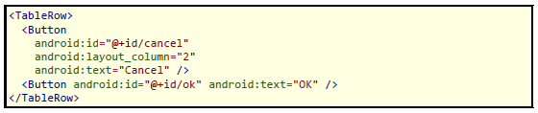
TableLayout
Ordinarily, widgets are put into the first available column
Can put a widget into a different column via the android:layout_column property, specifying the 0-based column the widget belongs to
In the following fragment, the Cancel button goes in the third column (column 2). The OK button then goes into the next available column, which is the fourth column.
Notes:
In the preceding fragment, the label would go in the first column (column 0), and the field would go into a spanned set of three columns (columns 1 through 3)

Slide 35
Non-row children in TableLayout
Normally, TableLayout contains only TableRow elements as immediate children
It is possible to put other widgets in between rows
For those widgets, TableLayout behaves a bit like LinearLayout with vertical orientation
The widgets automatically have their width set to fill_parent, so they will fill the same space that the longest row does
Notes:
One pattern for this is to use a plain View as a divider (e.g., <View android:layout_height = "2dip" android:background = "#0000FF" /> as a two-pixel-high blue bar across the width of the table).

Slide 36
Stretch, shrink and collapse
By default, each column will be sized according to the "natural" size of the widest widget in that column (taking spanned columns into account)
Can place an android:stretchColumns property on the TableLayout
Value should be a single column number or a comma delimited list of column numbers
Those columns will be stretched to take up any available space left in the row
To evenly spread all columns use stretchColumns=”*”

Slide 37
Stretch, shrink and collapse
Conversely, you can place an android:shrinkColumns property on the TableLayout
Again, should be a single column number or a comma delimited list of column numbers
The columns listed in this property will try to word-wrap their contents to reduce the effective width of the column
By default, widgets are not word-wrapped
This helps if there are columns with potentially wordy content that might cause some columns to be pushed off the end of the screen

Slide 38
Stretch, shrink and collapse
Can also use android:collapseColumns property on the TableLayout
Again, a column number or comma-delimited list of column numbers
These columns will start out "collapsed", meaning they will be part of the table information but will be invisible.

Slide 39
ScrollView
A ScrollView is a special type of Layout in that it enables users to scroll through a list of views that occupy more space than the physical display.
The ScrollView can contain only one child view or ViewGroup, which normally is a LinearLayout
Notes:
Example on page 96 of text book

